Slide 1

Intelligent Bot Experience Roberto Cervantes robece@microsoft.com

Slide 2
Conversation as a Platform
Human language is the new UI
Bots are the new apps; digital assistants are meta apps
Intelligence infused into all interactions
20% of mobile queries are voice searches
Notes:
Think of bots as new applications that you converse with. Instead of looking through multiple apps, or pages and pages of websites, you can call on any application as a bot within this conversational canvas.
Bots are the new ‘apps,’ and digital assistants are meta apps or like the new browsers. In this way, intelligence is infused into all of your interactions.
Think of a bot as an app that users interact with in a conversational way. Bots can communicate conversationally with text, cards, or speech.
A bot may be as simple as basic pattern matching with a response, or it may be a sophisticated weaving of artificial intelligence techniques with complex conversational state tracking and integration to existing business services.
In 2016 Google stated that over 20% of their mobile queries are not voice searches.
http://searchengineland.com/google-reveals-20-percent-queries-voice-queries-249917

Slide 3
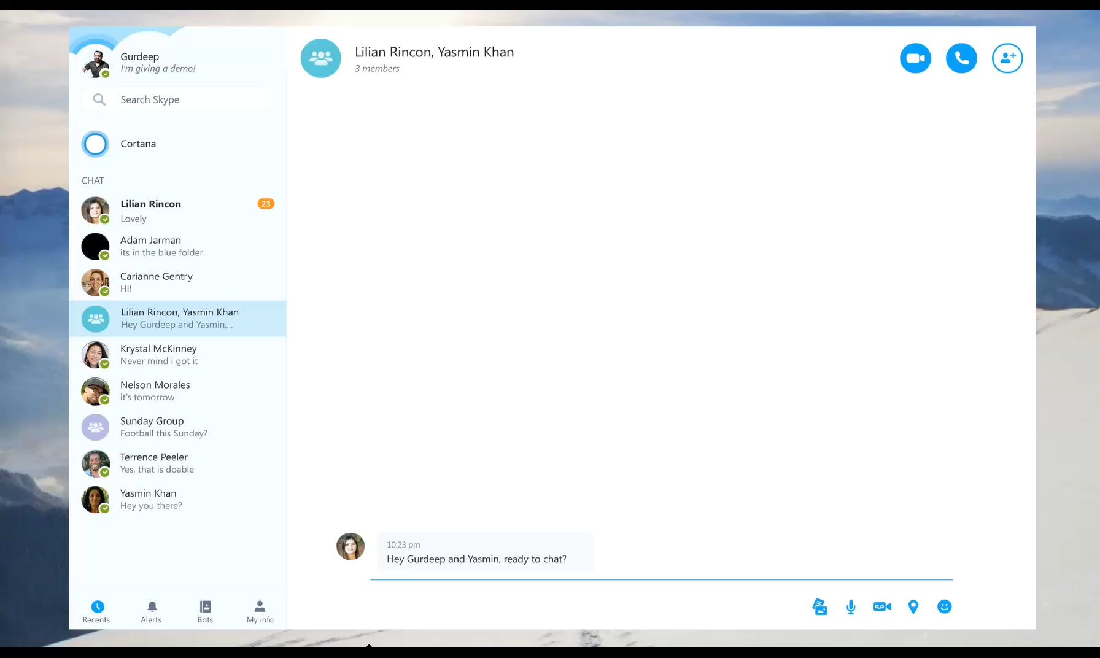
The Benefits of Bots
Reach users where they are, on any platform
Engage customers in a natural way; conversationally and in context
Expose products & services in messaging platforms, where users are highly engaged
Use AI to improve the customer experience and reduce the need for human intervention
Notes:
Data and device price decline
Engaging chat + content + services
5x growth over next 3 years
Young demographic
Higher retention & usage than apps
Opportunity for 1:1 connection
Allows for multiple inputs (users) to a single bot
Monthly users of messaging apps surpassed
Social apps a year ago

Slide 4
Designing a bot is very similar to designing an app
APP DESIGN
BOT DESIGN
Page driven
Dialog driven
SIMILAR OUTCOME
User receives results
Notes:
When using bots we don't have views, instead we have dialogs or conversation topics and navigation happens through conversation.
Very similar approach to building apps as bots.
Dialog takes a certain block of interactions and presents it as a step of the conversation, much like steps or links in the flow of webpage.

Slide 5
Conversation Flow
Layout and high-level structure of the conversation
Notes:
Let's look at this and how we would actually go about designing a bot.

Slide 6
Rough flowchart and copy
Locations
Bot Says | User Says
 | “Where can I get a coffee?”
I know lots of great places!
Let’s find a location close to you
Where are you at the moment?
 | “2 Kingdom St, London W2 6BD”
Here are the locations closest to W2 6BD
RESULTS:
Location Image
Name
Address
Hours
More Locations
 | “Starbucks”
Here’s more info on the Starbucks location
Location Image
Name
Address
Hours
Directions
More Locations
Current Location
No
Yes
Address
Valid
Location Search
No
New Search
Matches
Locations
More Locations
Location
“Directions”
Notes:
We did a flow chart for every conversation flow.
Reviewed with stakeholders, got feedback, refined.
We then wrote out every conversation flow in Excel to show back/forth.
Can use any tool you want, but want to show conversation, get feedback before coding…
TODO Color Code the responses
Potentially animate the process moving through the decision tree

Slide 7
The Microsoft Bot Framework
Build and connect intelligent bots to interact with your users naturally wherever they are.
Notes:
Now that we've got an idea about how to structure a conversation with a bot, lets take a look at the Bot Framework and what it offers.
Now that we have a good idea about how to structure conversation with bots, let's take a look at the MS Bot Framework and how it can help you to build bots and interact with your users wherever they are.

Slide 8
The Microsoft Bot Framework
Build Bots that support a range of communication channels with users.
The conversation can use simple text strings or more complex rich cards that contain text, images, and action buttons.
Design conversations in your bot to be freeform or offer guided interactions where the Bot provides the user choices or actions.
Add natural language interactions, which let your users interact with your bots in a natural and expressive way.
Notes:
- A bot is a web service that interacts with users in a conversational format.
- Users start conversations with your bot from any channel that you’ve configured your bot to work on (for example, Text/SMS, Skype, Slack, Facebook Messenger, and other popular services).
- You can design conversations to be freeform, natural language interactions or more guided ones where you provide the user choices or actions.
- The conversation can utilise simple text strings or something more complex such as rich cards that contain text, images, and action buttons.

Slide 9
Why use the Bot Framework
Developers writing bots all face the same problems: bots require basic I/O, they must have language and dialog skills, and they must connect to users, preferably in any conversation experience and language the user chooses.
The Bot Framework provides powerful tools and features to help solve these problems.
Notes:
Bot Framework provides infrastructure and interconnectivity to where your users are.

Slide 10
The Microsoft Bot Framework
Notes:
This is an overivew of the tech that we're looking at today and how it all fits together – lots of pieces don't get overwhelmed.
This is our roadmap of the day – we'll be breaking this down bit by bit.

Slide 11
How to develop your Bot
Bot Builder SDKs
Build bots with C# or Javascript using Node.js.
Open source SDK on Github
From simple built-in prompts and command dialogs to simple to use yet sophisticated ‘FormFlow’ dialogs
Libraries, samples and tools to make a great conversationalist
Chat emulator
Leverage related services available in Cognitive Services
Azure Bot Service
Speed up development by working in an integrated environment that's purpose-built for bot development.
Write, connect, test, deploy & manage right from your browser.
Notes:
How to develop your bot
There are several ways you can get started developing your first bot:
Bot Builder
Develop using your local IDE.
.net sdk
The Bot Builder SDK for .NET leverages C# to provide a familiar way for .NET developers to write bots.
node.js sdk
Bot Builder SDK for Node.js provides a familiar way for Node.js developers to write bots. The conversational logic for your bot is hosted as a web service. The Bot Builder SDK uses restify, a popular framework for building web services, to create the bot's web server. The SDK is also compatible with Express and the use of other web app frameworks is possible with some adaption.
Azure Bot Service
The Azure Bot Service provides an integrated environment that is purpose-built for bot development. Create a bot in seconds
It is powered by Microsoft Bot Framework and Azure Functions, which means that your bot will run in a serverless environment on Azure that will scale based upon demand.
https://docs.microsoft.com/en-us/bot-framework/azure/azure-bot-service-overview

Slide 12
Channels
The Bot Framework supports several popular channels for connecting your bots and people. Users can start conversations with your bot on any channel that you’ve configured your bot to work with, including email, Facebook, Skype, Slack and SMS.
Cortana
Bing
Facebook
GroupMe
Kik
Skype
Slack
Teams
Telegram
Twilio
Direct Line
Email

Slide 13
Activities & Messages
Activity
The Connector uses an activity object to exchange information between bot and channel. Any communication going back and forth is an activity of some type. Some activities are invisible to the user, such as the notification that the bot has been added to a user's contact list.
Message
A message is the most common type of activity. A message can be as simple as a text string or contain attachments, interactive elements, and rich cards. For example, adding a bot to the user's contact list could trigger the bot to respond with a message containing a string saying "Thank you!" and an image of a happy face.
Notes:
Activities make up any exchange between the bot and the end user.
Activity functionality can vary between different channels. E.g Skype will send an activity when a user starts typing, but we wouldn’t know in a Text Message.
A message is the most common type of activity, messages can range from basic text to interactive elements with buttons, images and videos.

Slide 14
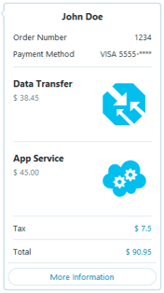
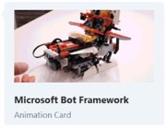
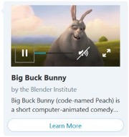
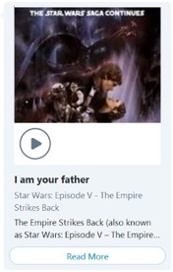
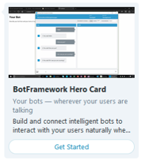
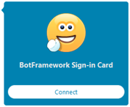
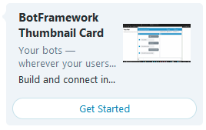
Rich Cards
A rich card comprises a title, description, link, and images. Rich cards act as templates for displaying data to a user.
A message can contain multiple rich cards, displayed in either list format or carousel format.
Receipt Card
Animation Card
Video Card
Audio Card
Hero Card
Sign-in Card
Thumbnail Card
Notes:
The Bot Framework currently supports eight types of rich cards:
Rich cards can be attached to messages to provide detailed responses to a user.
You can attach singular cards or multiple cards in a carousel.
https://docs.microsoft.com/en-us/bot-framework/dotnet/bot-builder-dotnet-add-rich-card-attachments

Slide 15

Adaptive Cards
Adaptive cards allow you to create custom and interactive chat bot cards.
They can contain any combination of text, speech, images, buttons, and input fields.
Adaptive Cards are created using the JSON format specified in Adaptive Cards, which gives you full control over card content and format.
Notes:
See examples at:
http://adaptivecards.io/samples/

Slide 16
Making your bots smarter
Intelligent bots respond as if they can see the world as people see it.
They discover information and extract knowledge from different sources to provide useful answers, and, best of all, they learn as they acquire more experience to continuously improve their capabilities.

Slide 17
Microsoft Cognitive Services
Enable natural and contextual interaction with tools that augment users experiences using the power of machine-based intelligence.

Slide 18
What are Cognitive Services?
The Cognitive Services are a collection of 29 complimentary ‘services’ to assist developers with the processing of natural input sources such as speech, images and emotion.
The Cognitive Services are organized into five pillars: Speech, Language, Vision, Knowledge and Search.
By combining different Cognitive Services developers can build intelligent apps with powerful algorithms using just a few lines of code.
Notes:
Microsoft has released a collection of 29 complimentary 'cognitive services' to assist developers with the processing of natural input sources such as speech, images and emotion.
The Cognitive Services are organised into five pillars: Speech, Language, Vision, Knowledge and Search.
Each of the pillars contains a subset of specific API's that provide granular control over how the information is processed.
Build intelligent apps with powerful algorithms using just a few lines of code.

Slide 19
Cognitive Services
Language
Vision
Speech
Search
Knowledge
LUIS
Spell Check
Linguistic Analysis
Text Analytics
Translator
Web Language Model
Computer Vision
Content Moderator
Emotion
Face
Video Indexer
Speech
Speaker Recognition
Translator
Custom
Autosuggest
Image
News
Video
Web
Entity
Academic
Entity Linking
Exploration
QnA Maker
Recommendations
Custom
Language Understanding
Custom
Vision Service
Custom
Speech
Custom
Search
Custom
Decision Service
Notes:
Here is an overview of all the Cognitive Services available.
We'll be looking at each of these today (some more than others) but by the end of it you'll have a better understanding of all the resources available to you.
Think of all these services as being like building blocks.
Putting them together in different ways to create a unique product or service.

Slide 20
Get started now
Learn more on the Cognitive Services website
and the Cortana Intelligence Suite website
Schedule a workshop to identify areas in your business where analytics and intelligence can drive transformation
Talk with your Microsoft contact about licensing options and partners

Slide 21
Resources
Sign up and get started today for free at
dev.botframework.com
www.microsoft.com/cognitive
Stack Overflow stackoverflow.com/questions/tagged/microsoft-cognitive
UserVoice Feedback Forum
cognitive.uservoice.com/

